Slide 1

IRONHACK
TRANSFER WINDOW
JOÃO LOPES | MICKAEL JOSSIER

Slide 2
Football and Data
Predict the 3 best players
We analyse a large amount of data, with the required expertise in interpreting and visualising data
And trust me it’s not an easy one, the same data set modelled two different ways can give almost polar opposite results, meaning that how data is interpreted is a key factor in how it is used and the views it helps to give on players.
The key question FC Ironhack club need to answer: what data matters for us?

Slide 3
Selecting the DATA, What Matters
We analyse Data from the players harmonised all the informations and suppressed informations poorly related to our main value (Overall, Ability)
To be able to do so we calculate for each Data set the coefficient of correlation with our Overall Ability.
We use two graph to illustrate our idea :
one for a data set highly related to our main value
second to show a data set with a relation almost not impacting our main value

Slide 4
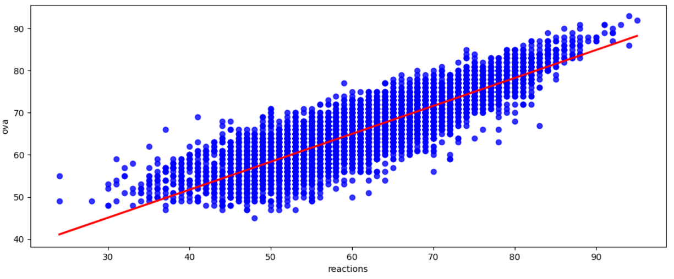
High correlation
“Reactions” strongly impacting “Overall ability” (corr = 0.874)

Slide 5
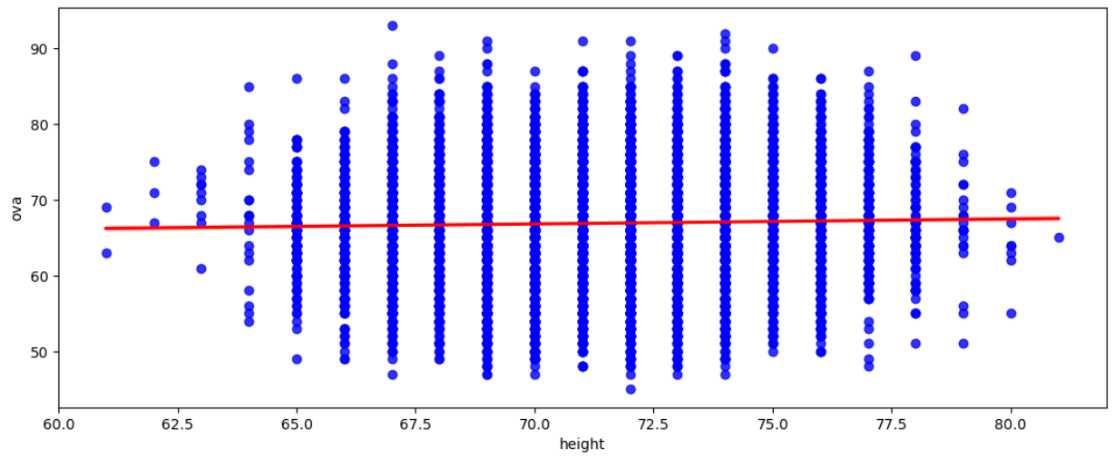
Low correlation
“Height” not impacting “Overall ability” (corr = 0.026)

Slide 6
Why we drop these Data
In the example before you could see that the line between data point is almost flat, meaning that the impact on our Overall Ability is a really small percentage. Why that?
As a player can be or small or tall both can be advantageous on the field depending of the position of the player.
Example :
Height is a bonus for players in defensive position. They use their height to get on top of other players.
However, shorter players usually have faster reaction time during defense and can pass the ball better.

Slide 7





Filtering the sample
Top 1500
players (> 10%)
↓
Accurate
predictions
Model based on 100% of the players → Inaccurate predictions
= 500 players

Slide 8
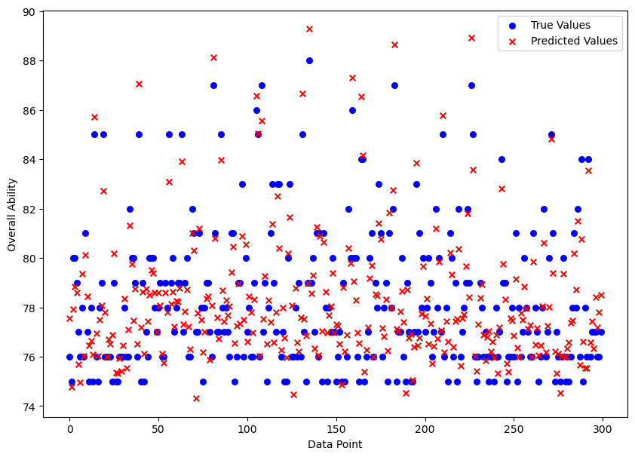
True values compared to predicted values

Slide 9
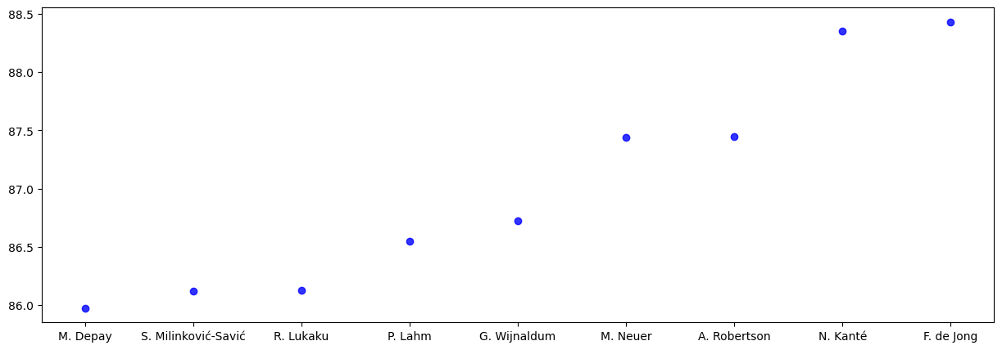
Applying the model
Predicted overall ability of some players

Slide 10





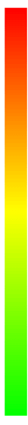



Different approach: Automation
Error Variable (column)
Model

Slide 11



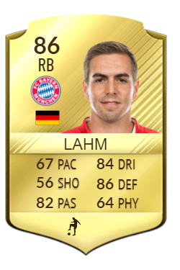
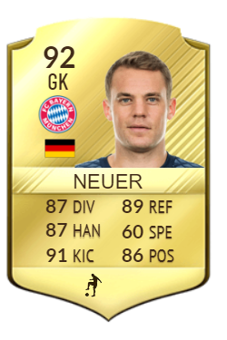
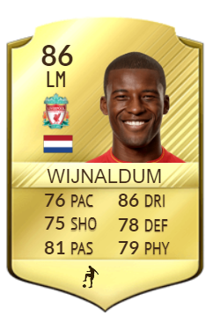

Selected players

Slide 12

WINDOW CLOSED

